Slide 1
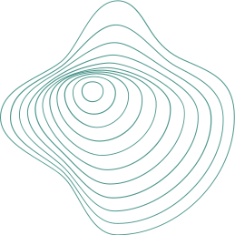
ECE504- INTERNET OF THINGS
Citizen Safety Device
Guided by: Anurag Lakhlani

Slide 2
Kesha Bagadia (AU1841011)
Manal Shah (AU1841026)
Yashvi Gandhi (AU1841033)
Yashvi Pipaliya (AU1841092)
Team Members

Slide 3
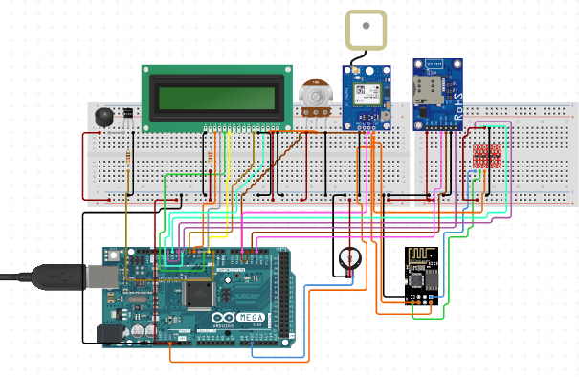
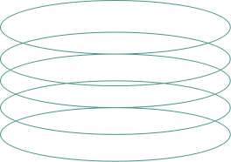
Circuit Diagram

Slide 4

Project Video

Slide 5
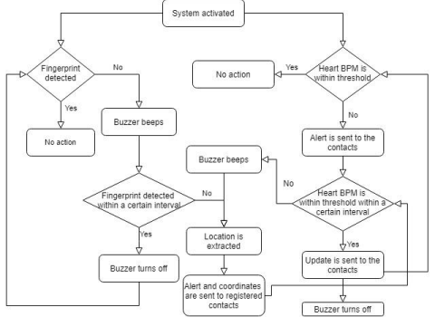
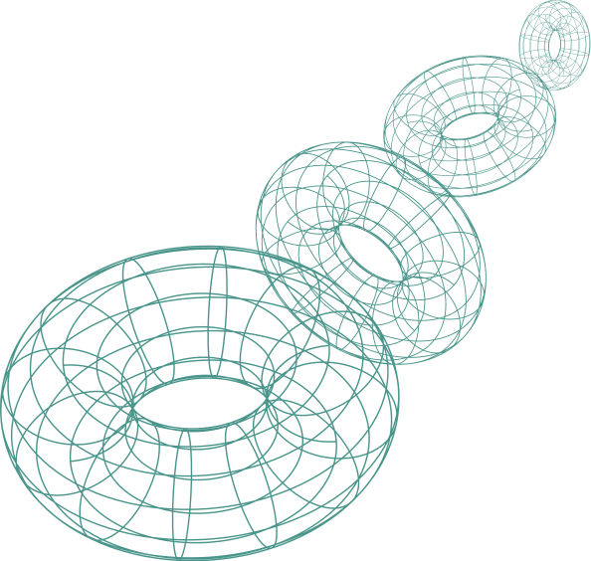
Flowchart

Slide 6
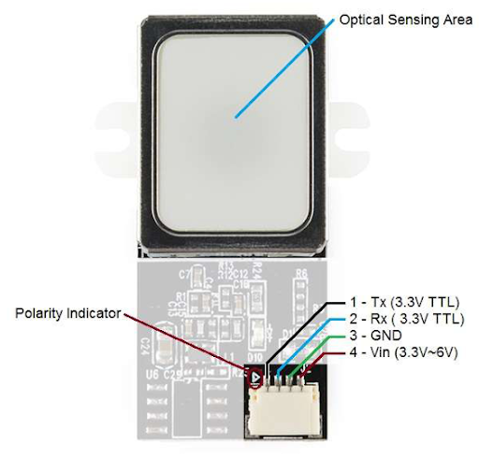
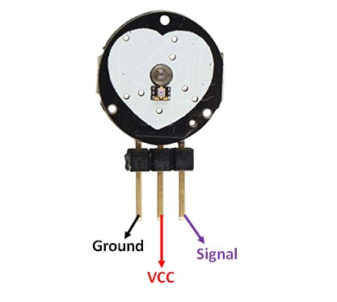
PBL Components
Fingerprint Scanner - TTL (GT-511C3)
Heart Rate Pulse Sensor

Slide 7
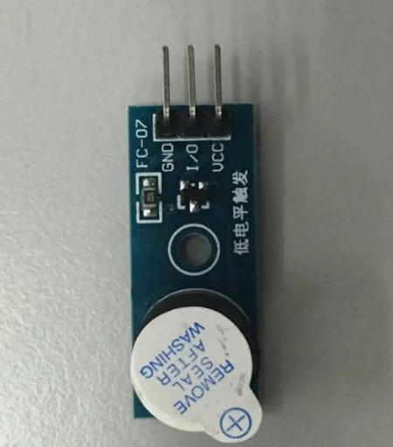
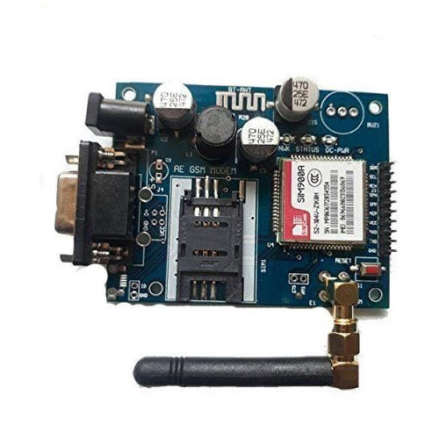
PBL Components
Buzzer
GSM Module

Slide 8
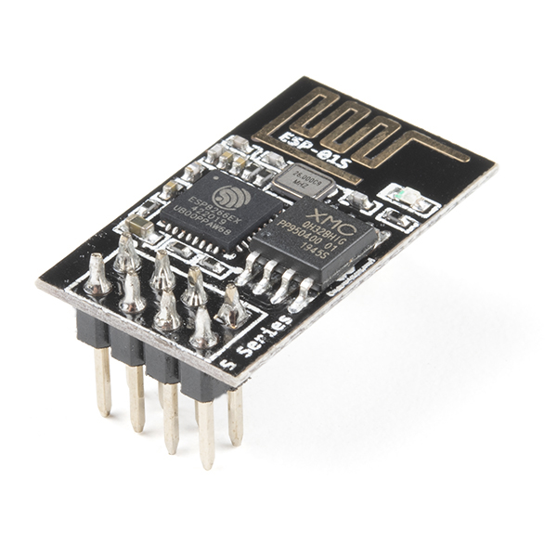
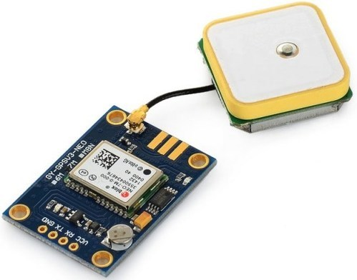
PBL Components
WiFi Module- ESP8266
NEO 6M GPS Module

Slide 9
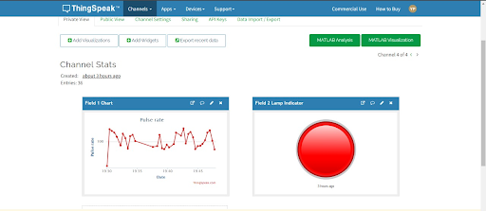
PBL Components
ThingSpeak

Slide 10
Hardware/Software Problems
NEO-6M GPS Module
Problem: Not able to get any data from Neo-6M (GY-GPS6MV2) connected to Arduino
Connections: GND - GND, TX - D3, RX - D2, VCC - 5V
After referring the datasheet, we found that the baud rate should be set to 9600 for the module to work and GSM module’s operating voltage is between 2.7V-3.6V, so changed the supply voltage to 3.3V.
VCC - 3.3V
int GPSBaud = 9600;

Slide 11
Hardware/Software Problems
2. GSM MODULE
Problem: The program is not loaded successfully.
Connections old: GND - GND, TX - 0, RX - 1, VCC - 5V, GSM Module Vol - 12V
Connections new: GND - GND, TX - 9, RX - 10, VCC - 5V, GSM Module Vol - 12V
3. Heart Rate Pulse Sensor
Problem: Sensor not working properly
Debugging & Troubleshooting: According to the datasheet given, the operating current should be 3-4mA and it seemed that the current it received was more for some reason due to which it got short circuited.

Slide 12
Real Life Implementations
Nowadays we see many monitoring device systems integrated in a smartwatch or in a smartphone or in any wearable technology. Thus our safety device can be incorporated into a mobile device or smart watch so that it becomes very convienient for the users to carry around various places
The system is encapsulated with a waterproof and weather resistant shielding so there won't be any problem unless the phone/watch is damaged. Also, these days we find coating which helps in maintaining the temperature so that sensors can work properly. And the system will be using the power generated from the phone's/watch’s battery.
This device can be use the solar powered battery so that there would no issues regarding drainage of the battery or charging the device and secondly it is sustainable and environment friendly

Slide 13
3 Scenarios
All the components are wired and are not composed into a neat system, therefore, it’s only usable when it is converted into a compact, wearable device. The most important component in them is Microcontroller and these MCUs need to be small and at the same time perform more functions, integration becomes another important factor.
Size- These devices must be small so that they can easily fit on to a wearable. Nevertheless, at the same time they must integrate more features in the same space.
Since wearable devices are battery powered, reducing the power consumption of these devices poses unique challenges. 32-bit ARM architecture is a popular CPU technology for wearable devices as it provides best performance and energy efficiency

Slide 14
References
N. Viswanath, N. V. Pakyala and G. Muneeswari, "Smart foot device for women safety," 2016 IEEE Region 10 Symposium (TENSYMP), 2016, pp. 130-134, doi: 10.1109/TENCONSpring.2016.7519391.
Women Safety Device with GPS Tracking and Alerts Using Arduino (https://circuitdigest.com/microcontroller-projects/arduino-based-women-safety-device-for-emergency-alert-and-tracking)
https://create.arduino.cc/projecthub/abiodun1991/developing-a-device-for-heart-rate-using-pulse-sensor-22746c
Womens Safety Device With GPS Tracking & Alerts (https://nevonprojects.com/womens-safety-device-with-gps-tracking-alerts/ )
https://microcontrollerslab.com/sim900a-gsm-module-pinout-examples-applications-datasheet/
https://www.youtube.com/watch?v=nUcrrCJd1sY
https://create.arduino.cc/projecthub/hugonator/simple-lcd-timer-with-arduino-uno-ff3376

